Slide 1


Mobile Manipulator UROP project
Final presentation
Xinyi Jiang, University of Cambridge
Supervised by Fumiya Iida

Slide 2
Overview
Introduction
Application scenarios
Technical details
Demonstration of application scenario
Next steps
Notes:
Here’s an overview for today’s presentation.

Slide 3
Introduction
Notes:
We begin with the introduction.

Slide 4

Focus group - elderly
Ageing population
Shortage of caregivers
Opportunity for technology
Age at home
Independence
Notes:
To guide the research topic, we focused around the elderly. Advances in healthcare and standards of living have given us increases in life expectancies and drops in birth rate.
As a result, many countries face a similar population trend – senior citizens are now taking up a larger proportion of a country’s population.
However, the number of caregivers cannot catch up with this trend. The mismatch in supply and demand of caregivers becomes an opportunity for technology.
Most seniors in good health will prefer to age at home; preserving independence is the key to maintain their way of life.
How can domestic robots support aged individuals to live independently? What would these robots look like?

Slide 5
Application scenarios
Notes:
Let’s take a look at some ideas for what these robots can become.

Slide 6

Mobile base
Notes:
It all starts with a mobile base. On its own, it’s unassuming in its simplicity, but there are endless ways to extend its capabilities.
Some of these applications are not limited to elderly assistance.

Slide 7
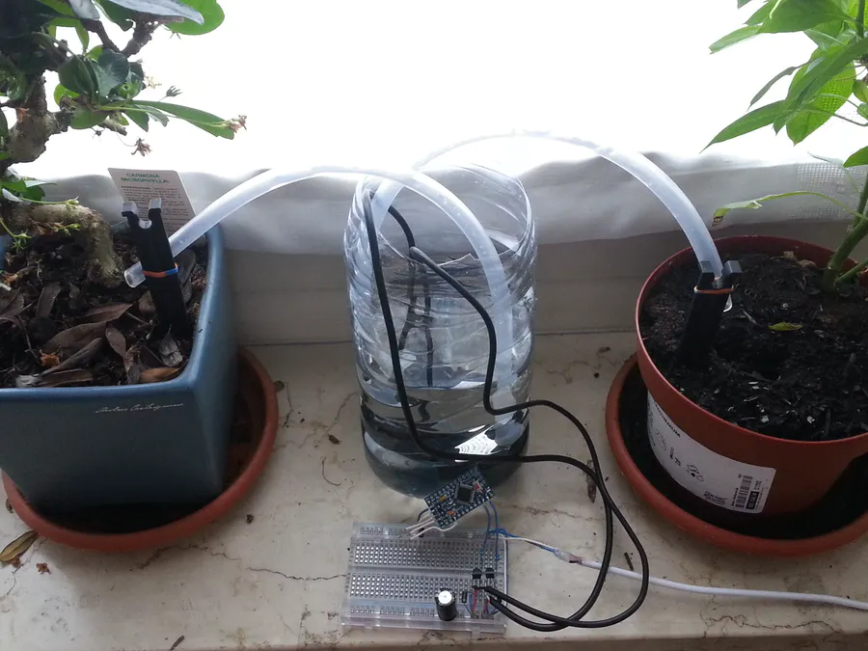
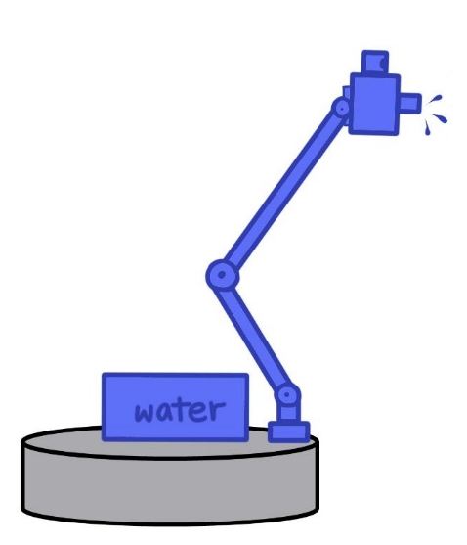
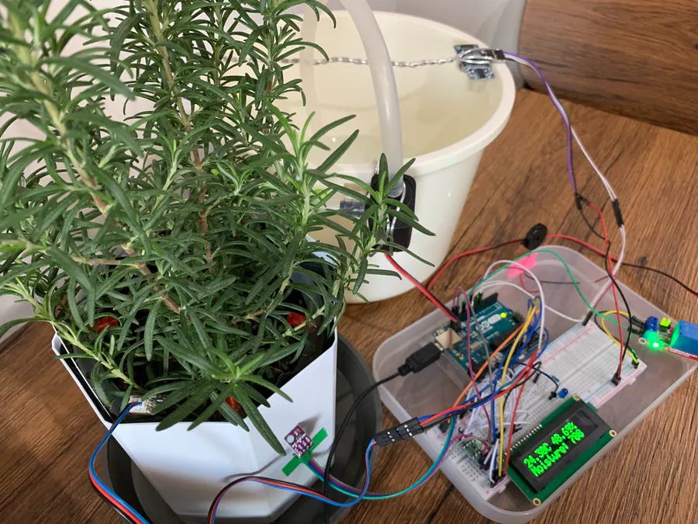
Indoor plant watering
Option for teleoperation takeover
Dispenses the required amount of water for each plant
Self-charging and refilling
Autonomously navigates to a thirsty plant
Notes:
Did you know that the most common cause of plant demise is too little and too much water?
I’m sure some of us are guilty of accidentally letting plants go dry, and then we overcompensate and flood the pot. This problem may be exacerbated in cases involving age-related memory loss.
What if we have an agent that takes over the role of watering plants. They can remember the specific needs of each plant and keep to a regular watering schedule.
That way, we can have all the benefits of indoor plants without all the work of keeping them alive.
Most solutions are hobby projects that people hacked together. Maybe it’s time for something more proper.

Slide 8
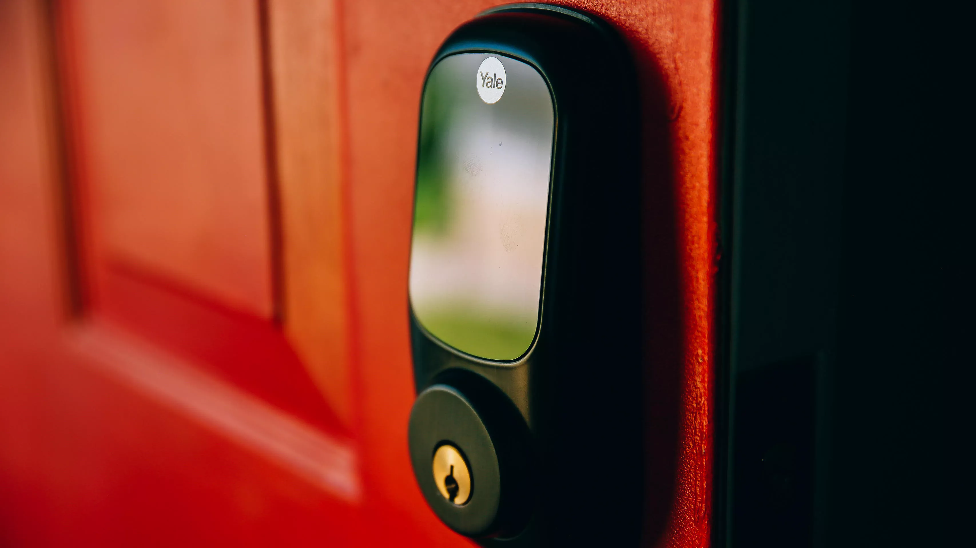
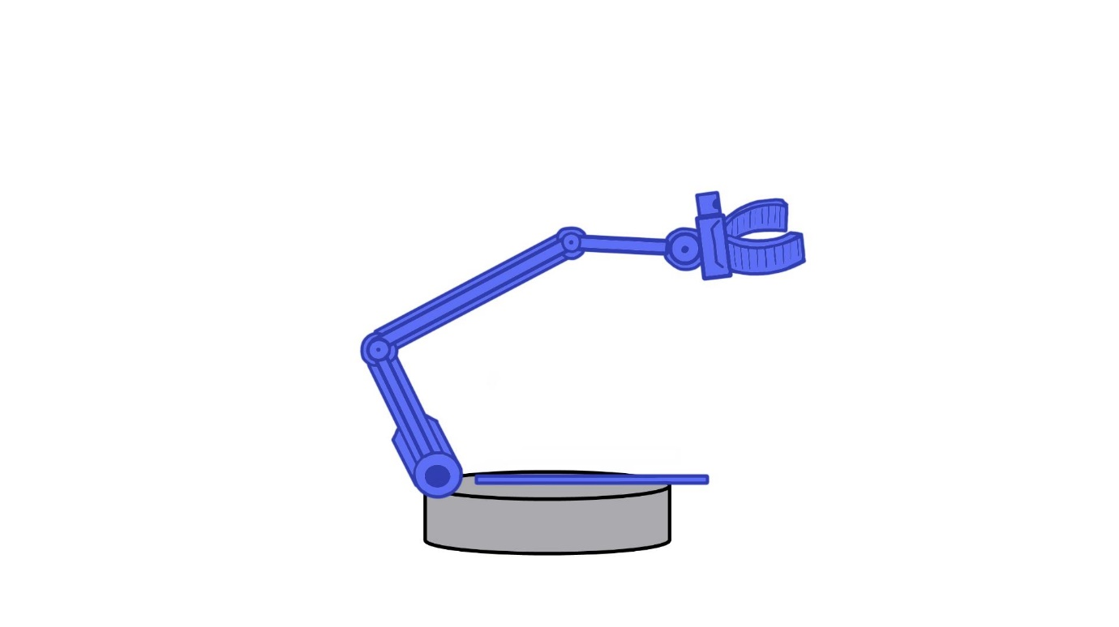
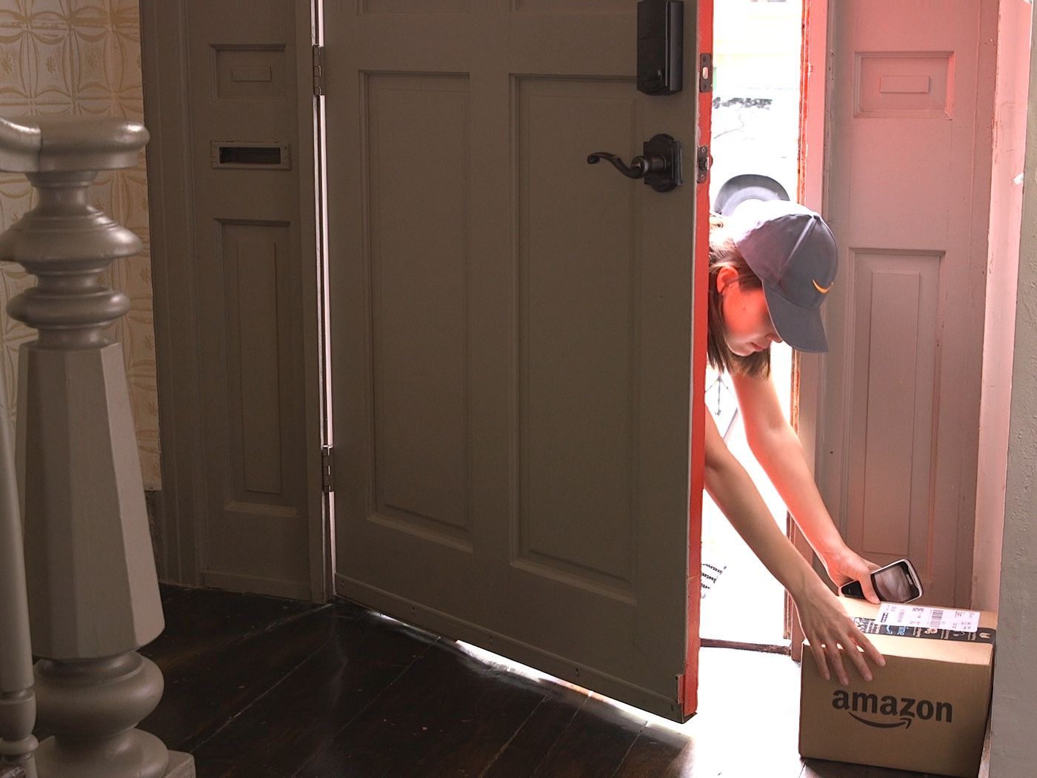
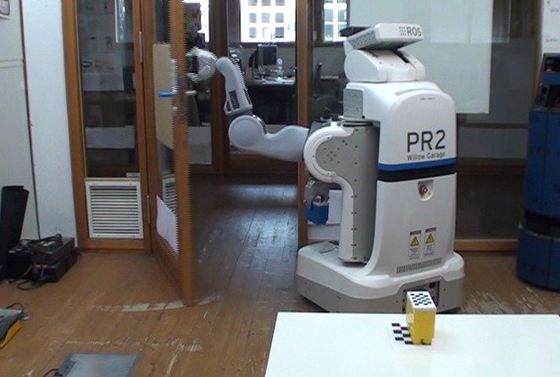
Away-from-home delivery handling
Livestream for monitoring the process
Adaptive dexterous arm to open doors
Platform for packages
Reports status of delivery
Notes:
Online shopping has become increasingly popular. However, sometimes people cannot be at the door when their orders are delivered.
Failed delivery attempts create extra hassle for the homeowner, who has to rearrange deliveries or go to pick-up lockers. Wouldn’t it be nice if someone was always at home to receive packages?
We have services that allow delivery people to drop off parcels in the home, and we have robots that can open doors, but no one has really put these ideas together.

Slide 9
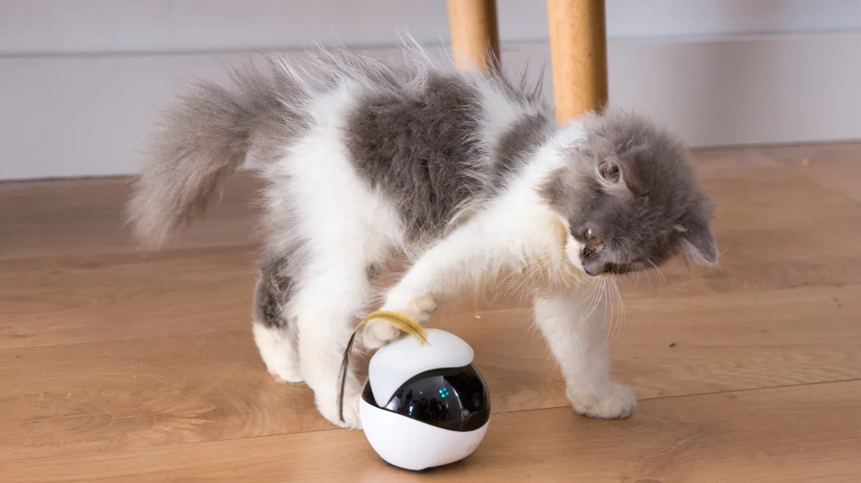
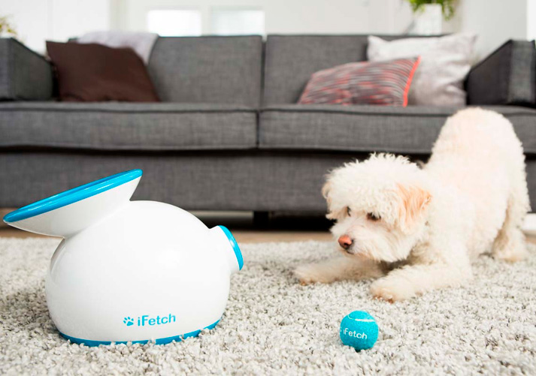
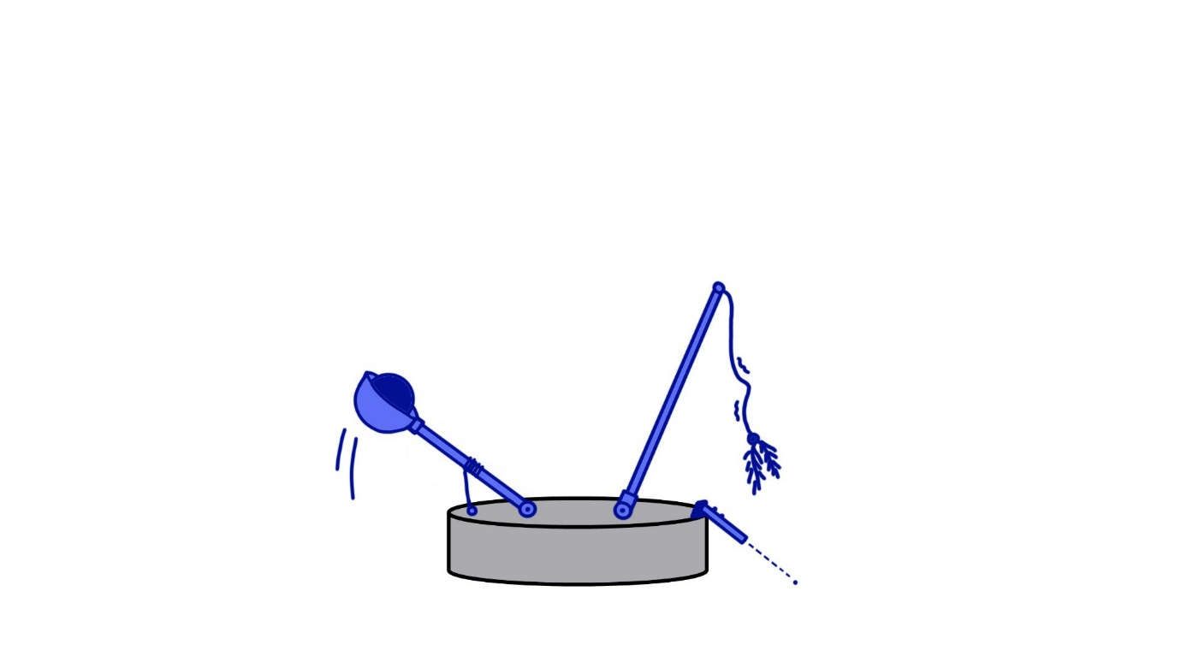
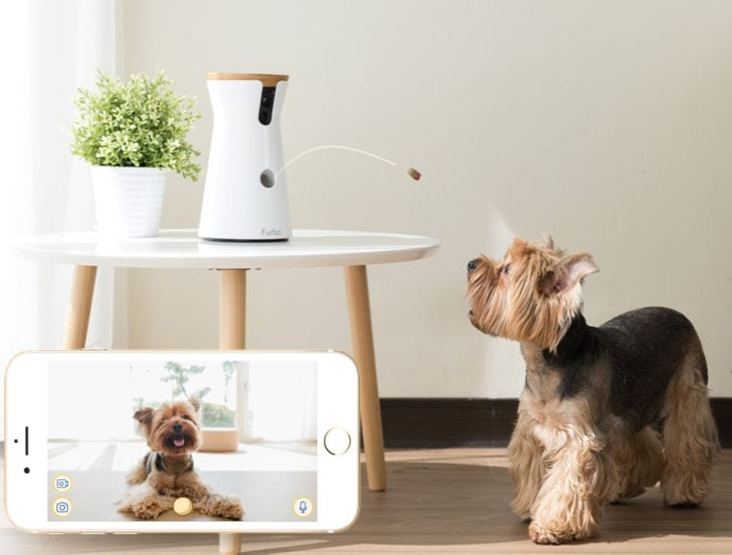
Pet entertainer
Throws balls
Waves a tassel wand
Remotely monitor pets activity
Points laser beams
Notes:
To combat loneliness, seniors sometimes choose to have a pet as a companion through their older years.
However, when it comes to physically demanding activities like playing catch or tug of war, their limited mobility means they have to give it a pass.
The lack of stimulation may cause a pet to get into mischief to curb their boredom. Mobile robots may be the solution to preoccupy our four-legged friends.
There are some products targeted towards pets, but there is room for growth.

Slide 10
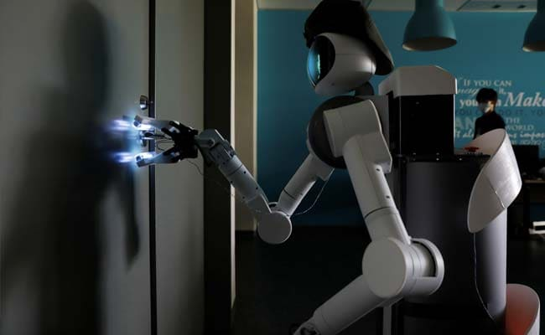

Targeted disinfectant
Monitors surfaces touched by people
Disinfects with a sanitising solution
Manoeuvres around living spaces
Autonomously navigates to high-touch surfaces that need to be cleaned
Notes:
As people age, their immune response weakens significantly, making seniors more vulnerable to bacteria and viruses infections.
People unintentionally harbour all kinds of microorganisms on their hands as they interact with things throughout the day.
Since these pathogens are invisible to the naked eye, they are impossible to detect. How can homeowners keep pathogens at bay if they cannot see the enemy?
The solution is to keep track of high-touch surfaces, and target them specifically with disinfectant, providing peace of mind that their house is clean.
As far as I’m aware, no such solution exists in the market yet. The closest thing is I can find is a remote-controlled robot with a UV light hand attachment to kill viruses on door handles.

Slide 11
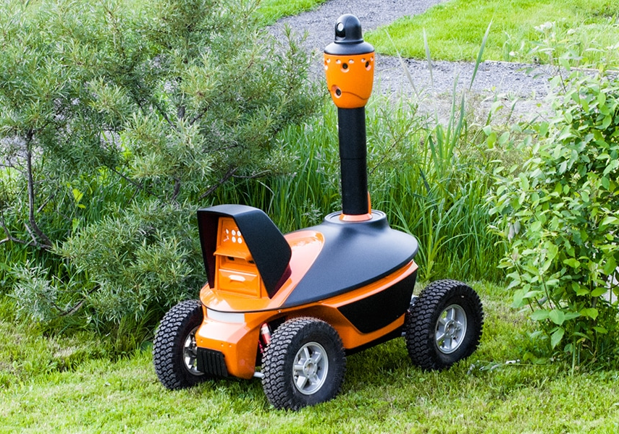
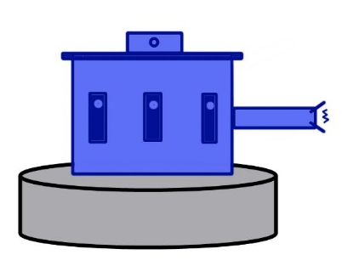
House guard
Gives house status updates
Sensors to monitor state of house
Non-lethal weapon for intimidation
Makes regular patrols around the home
Notes:
Robots can give homeowners peace of mind with an extra set of eyes and ears to watch over their abode when no one is at home.
Equipped with an array of monitoring and defensive capabilities, the robot will protect the house with devotion and loyalty, keeping it safe from intruders.
Mobile security systems exist, but they are usually designed outdoor and for commercial spaces. An equivalent domestic counterpart remains yet to be seen.

Slide 12
Technical details
Notes:
Now that we’ve looked at some exciting application scenarios, let’s turn our attention to the technical details of the mobile robot used in this project.

Slide 13
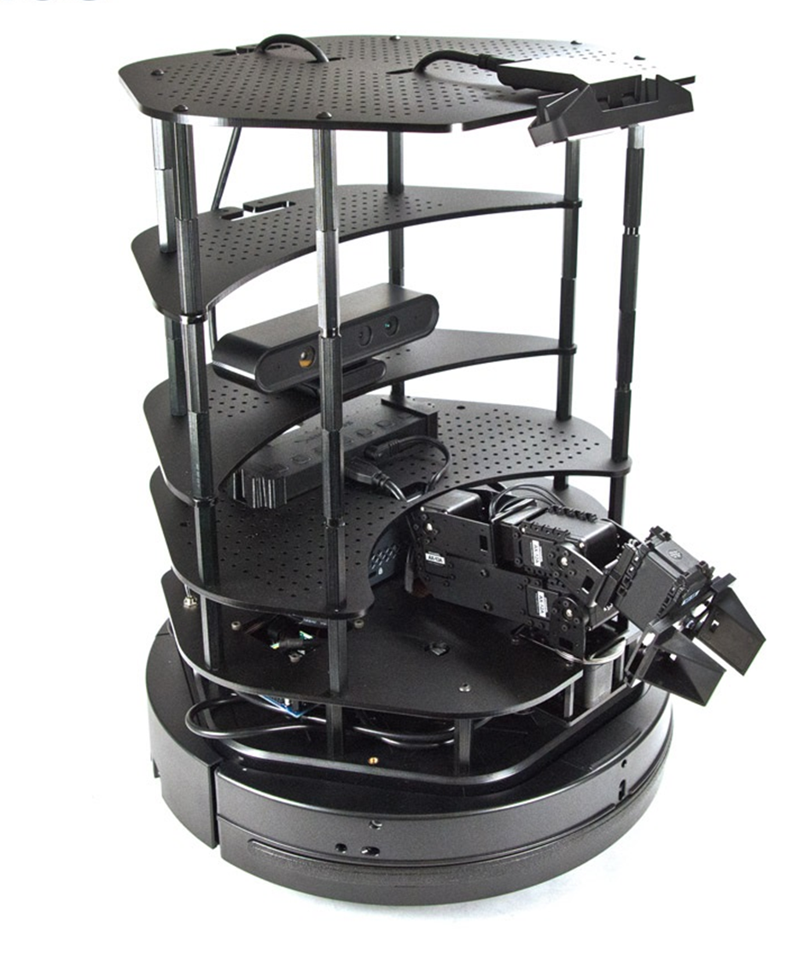
Turtlebot2i robot platform
Open-source
Mobile base
RGB-D cameras
Manipulator arm
Robot Operating System (ROS)
Notes:
The turtlebot2i is an open-source, low-cost robotic platform suitable for research and education.
It comes with a mobile base, a pair of depth cameras, a robotic arm, and runs ROS on an onboard mini PC.
ROS manages communication between executable files.

Slide 14
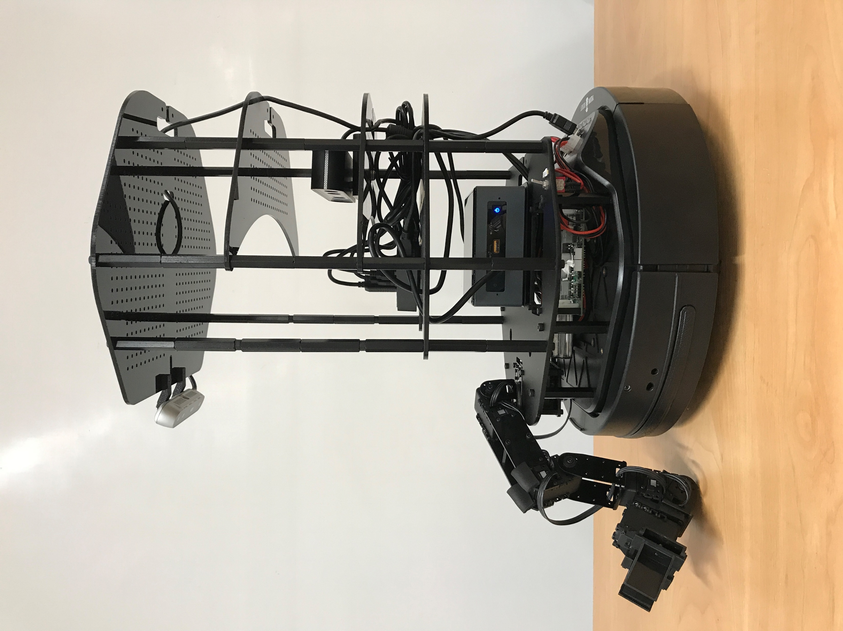
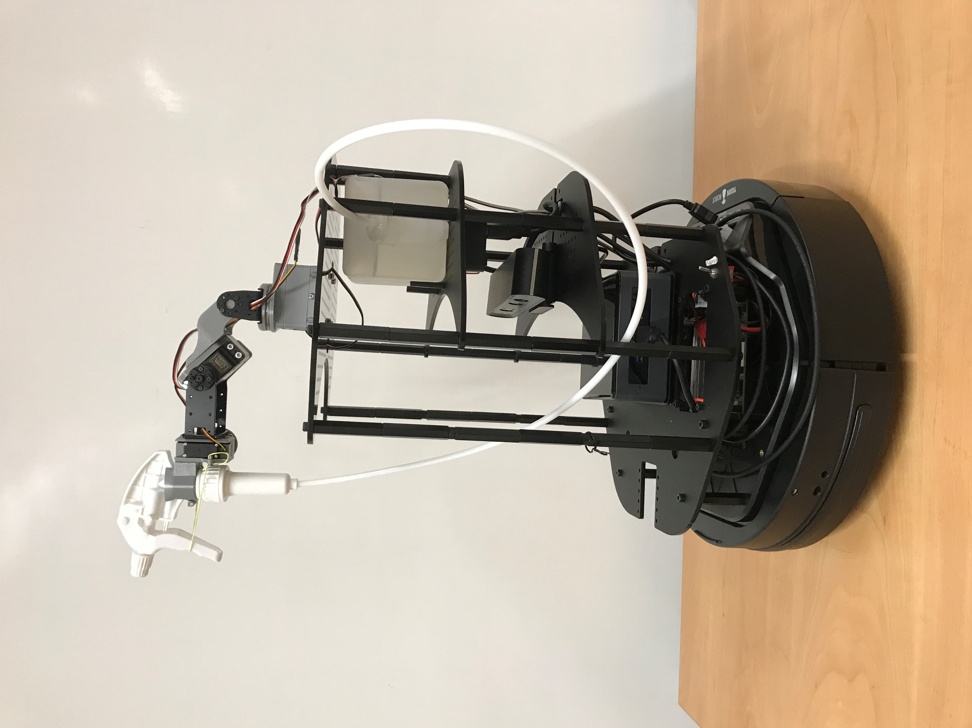
Before modifications
After modifications
Notes:
In order to make the platform suit our needs, some features were changed.
Most notably, the arm was revised and a water tank was added.

Slide 15
Demonstration of application scenario
Notes:
This brings us to the demonstration of how it can be used for our application scenario.

Slide 16
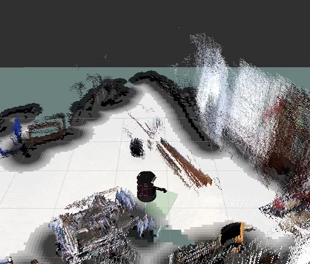
Mapping the environment
Simultaneous Localisation and Mapping (SLAM)
Real-Time Appearance-Based (RTAB) map
Point cloud & occupancy grid
Teleoperation
Notes:
A robot needs a map of the environment to estimate its own location, but it needs to know its own location to generate the map. SLAM gives us an approximate solution to this “chicken and egg” problem.
The turtlebot uses an RGB-D based SLAM approach to build its RTAB map. The navigation stack generates a dense 3D point cloud of the environment and creates a 2D occupancy grid.
Mapping of new environments is user-controlled via teleoperation.

Slide 17
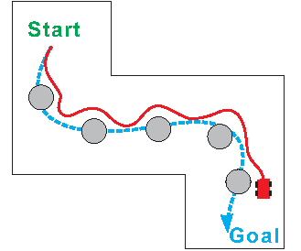
Navigation
Global and local path planners
Set goal
Odometry, sensors & map feedback
Notes:
The global planner generates the shortest path from start to goal, while the local planner avoids obstacles in its immediate environment.
When the turtlebot receives a plant destination goal, it will calculate a trajectory based on the desired goal and planner information.
It uses information from odometry, sensors, and the environment map to guide its decisions.

Slide 18
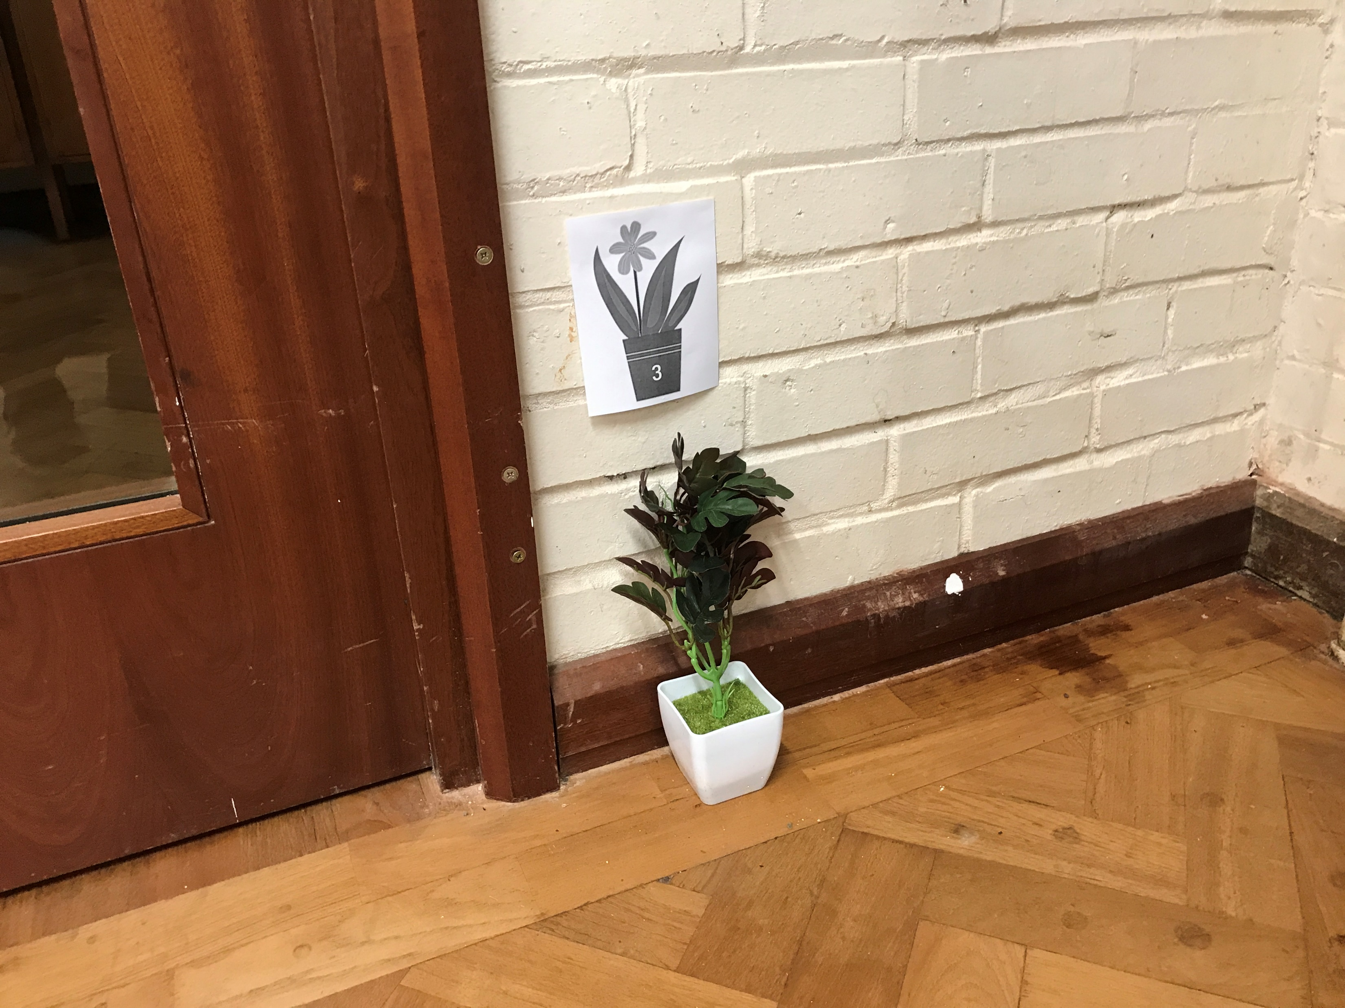
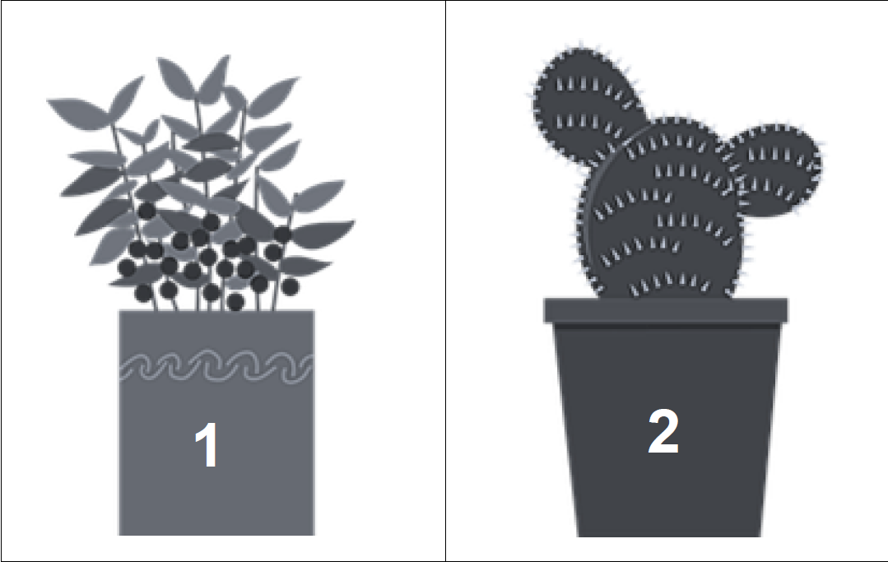
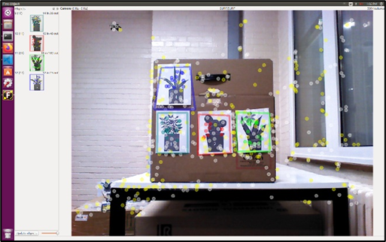
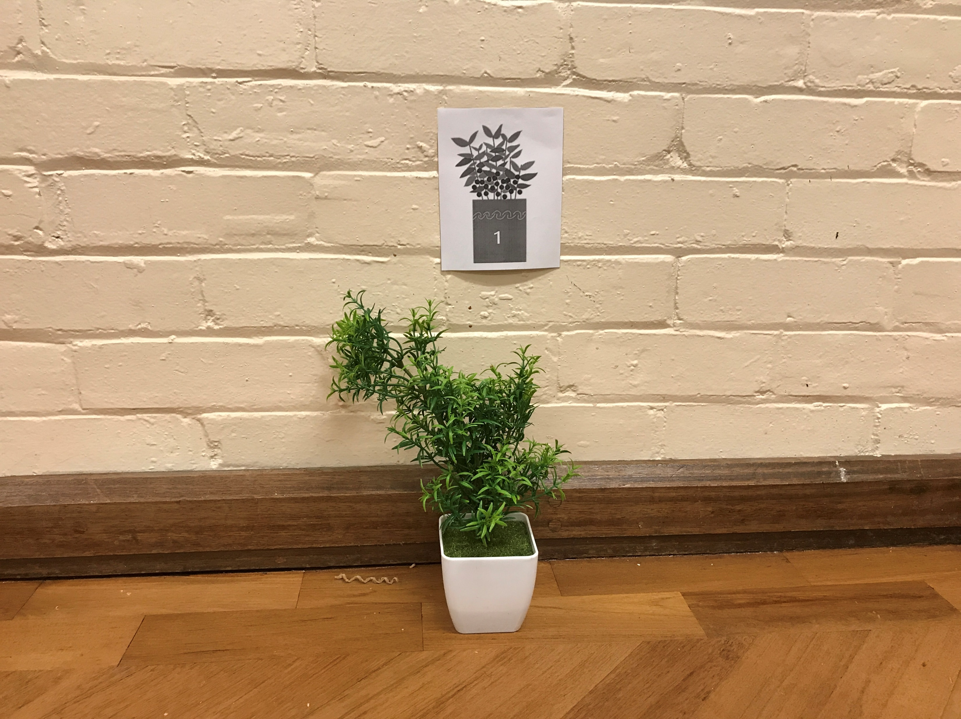
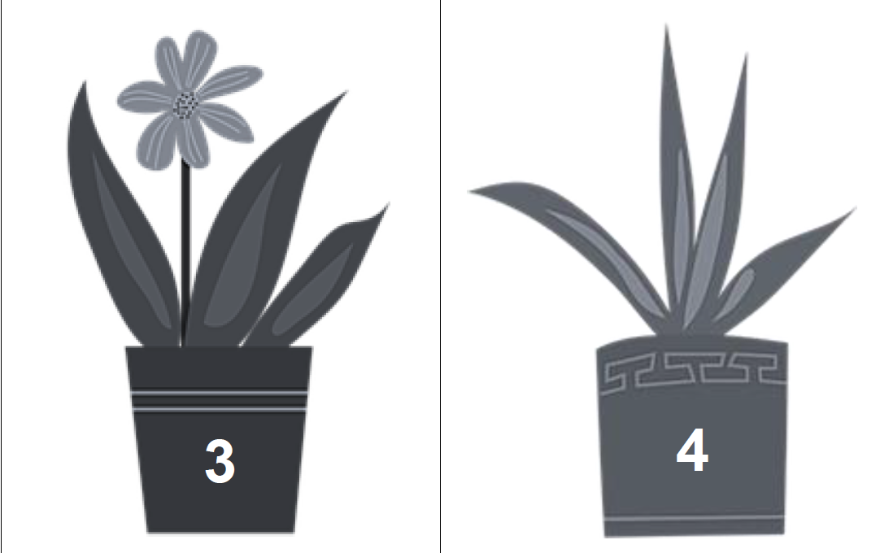
Plant markers
Notes:
Four plant markers were used as goals for the path planner. Characteristics like points, lines, edges, colours, and their relative positions help with their identification.
The markers were placed around the room adjacent to potted plants, at roughly the same level as the turtlebot’s camera.

Slide 19
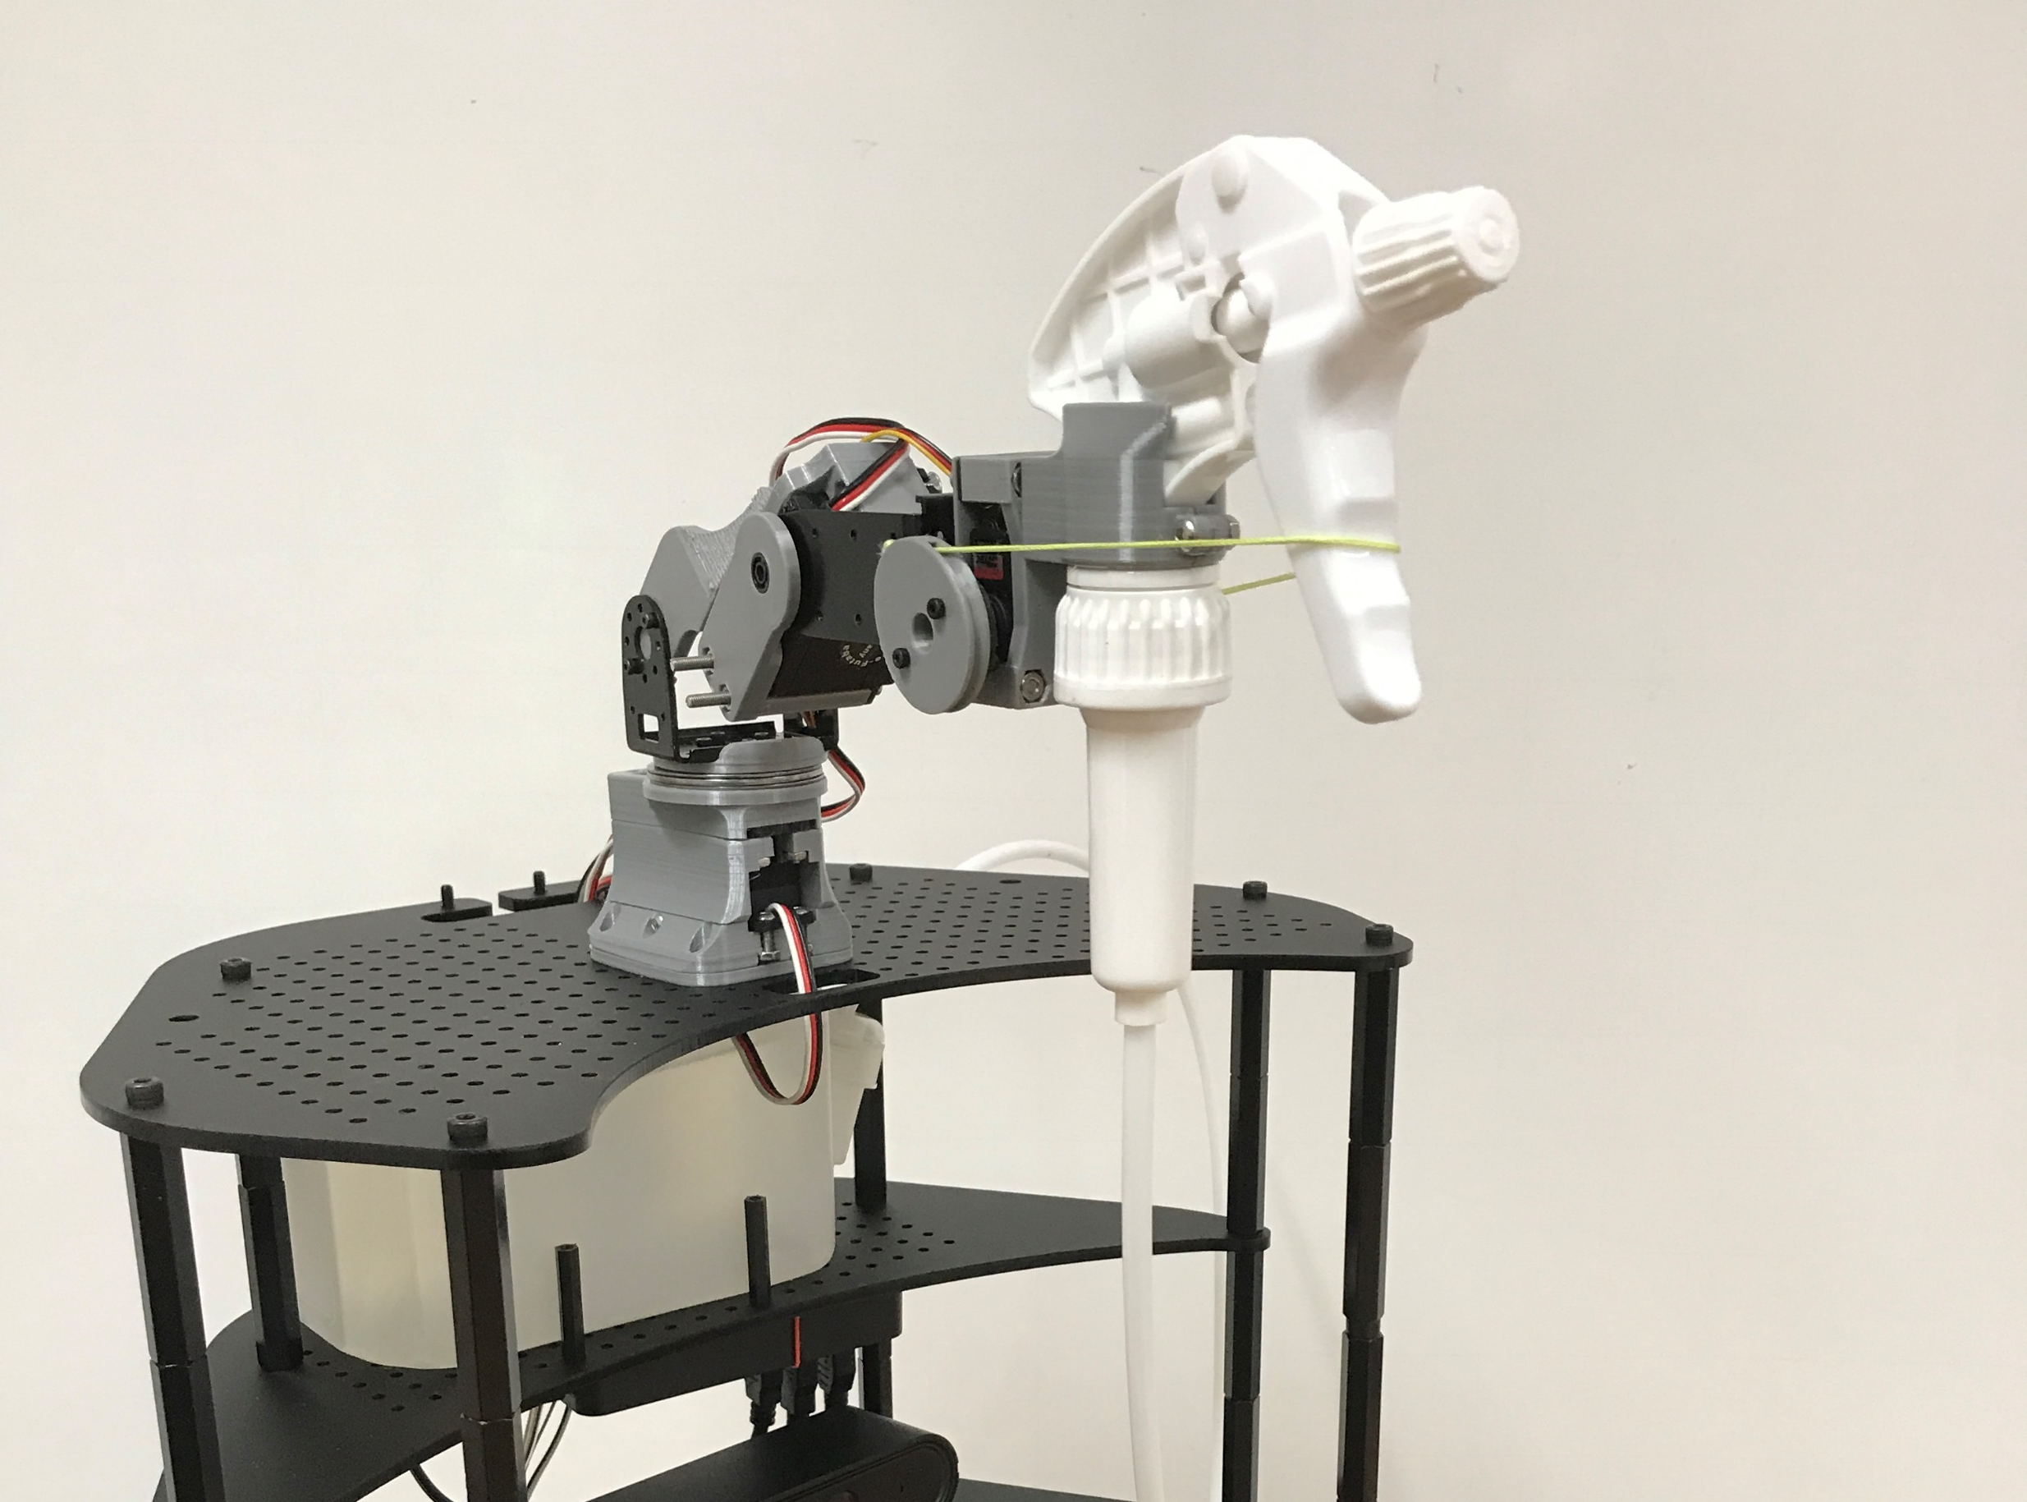
Watering
OpenCV for aim
Positioning of arm
Dispenses water
Continues to next goal
Notes:
Once the turtlebot arrives at its destination, OpenCV was used to improve the aim of the stream of water.
The depth and position information from the plant are used to estimate the arm pose.
Once the pump dispensed water, the arm retracts and the turtlebot moves on to the next plant until all plants have been watered.

Slide 20
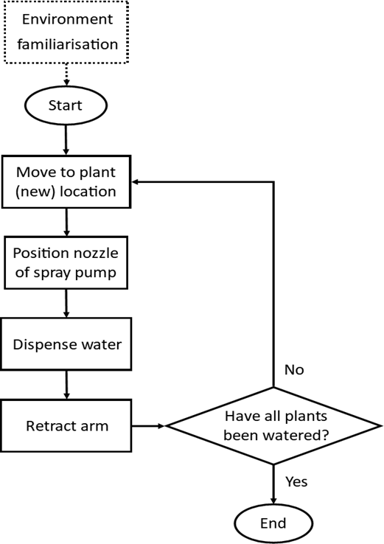
Sequence
Notes:
Overall, the flowchart looks like this.

Slide 21
Video demonstration

Slide 22
Next steps
Notes:
Now that this UROP has reached its end, what are the next steps?

Slide 23
Future work & areas for improvement
Overcome design shortcomings
Greater degree of autonomy
Adapt to make targeted disinfectant
Notes:
The most prominent design flaws of the current robot are that its electronics are prone to water splashes, and it has a hard time detecting low lying obstacles like cables.
The turtlebot can be further developed to monitor the state of the plant so that they would be tended based on their soil conditions instead of by the users request.
Another idea for implementation is to remove human involvement from the setup sequence when the map is first constructed by using a diligent exploration algorithm.
Not sure if you noticed, but the targeted disinfectant concept shares many of the same features as the plant watering concept. Future work could involve adapting the existing platform to accomplish disinfecting tasks.

